Slide 1
Coastal City
Jinzhou, Liaoning Province, China
BY Celine Lin& Andy Li& Fred Jiang& Simon Liang

Slide 2
Global warming
Problem
Sea level rises
Seawater intrusion & Salinization

Slide 3
Jinzhou, a city in Liaoning Province
Locate at the north of Liaodong Bay of Bohai sea.
The salinization region mainly assemble at the west of Daling river estuary and the east of the Xiaoling river estuary.
The area of the salinization region is 560 square kilometers
The distance of the salinization region from the land area is about 0 kilometers.
More details

Slide 4
For agriculture：
soil compaction
soil fertility decline crop reduction
plant simplification
the regional ecoogical function decline
For industry：
destroy the automatic water supply machine and the underneath
For residents：
the quality of drinking water was negatively affected
endemic diseases spread
Harm

Slide 5
Our SOLUTION:
Build a wetland Park

Slide 6
The functions of wetland

Slide 7
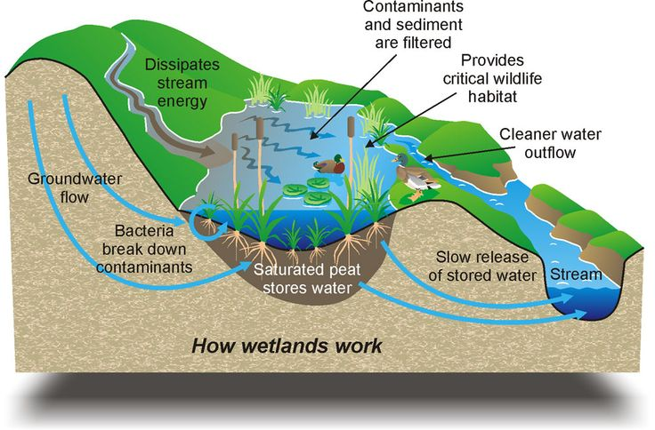
Functions

Slide 8
Functions
1. Prevention of salt water intrusion.
2. Water supply
3. Recharge groundwater
4. Remove and transform the poisons and impurities
5. Habitat of wild animals
6. Reserve nutrients

Slide 9
Commercialization of
the wetland park

Slide 10
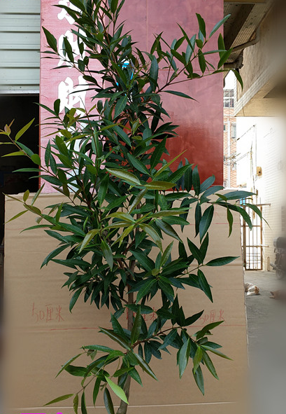
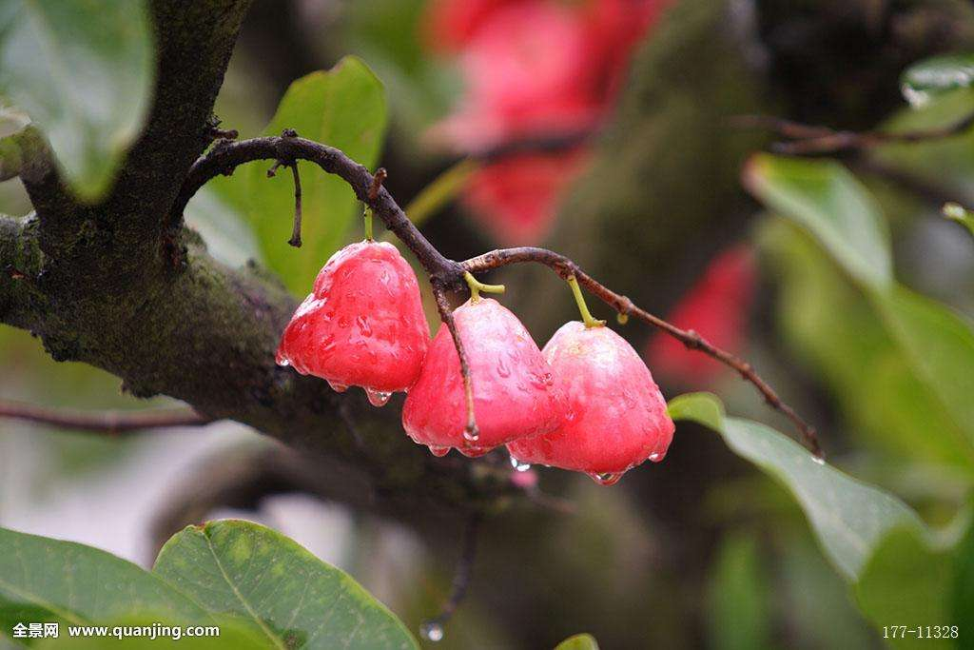
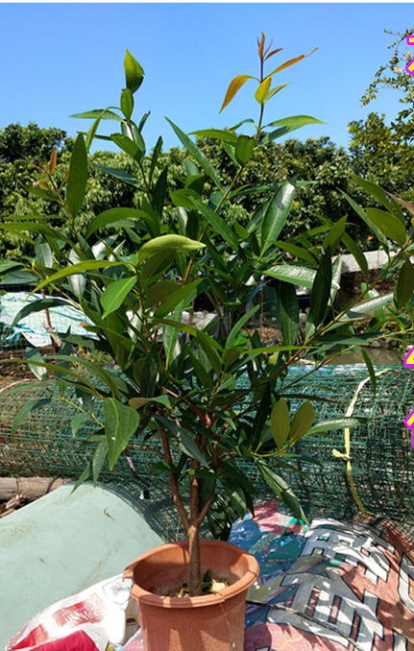
Syzygium jambos（L.）Alston

Slide 11
Planting
plan
Builder of the park
Salinization: solved
Economic benefit: solved
Entertainment: solved
Visitors together

Slide 12
THX!

